Slide 1

1.4 Operators and Expressions
academy.zariba.com
<number>

Slide 2
Lecture Content
Operators in C# and Order of Operators
Arithmetic Operators
Logical Operators
Binary Number System
Bitwise Operators
Comparison Operators
Assignment Operators
Other Operators
Implicit and Explicit Type Conversions
Expressions
<number>

Slide 3
What is an Operator
Operator is an operation performed over data at runtime. Takes one or more arguments and produces a new value.
Operators have order – determines which will be evaluated first.
Expressions are sequences of operators.
<number>

Slide 4
1. Operators in C#
Unary – take one operand
Binary – take two operands
Ternary – takes three operands
<number>

Slide 5
Operator Types in C#
Category | Operators
Arithmetic | + - * / % ++ --
Logical | && || ^ !
Binary | & | ^ ~ << >>
Comparison | == != < > <= >=
Assignment | = += -= *= /= %= &= |= ^= <<= >>=
String concatenation | +
Type Conversion | is as typeof
Other | . [ ] ( ) ?: new
<number>

Slide 6
Order of Operators
From Highest to Lowest:
( ) ++ -- (postfix) new typeof
++ -- (prefix) + - (unary) ! ~
* / %
+ -
<< >>
< > <= >= is as
== !=
&
^
|
&&
||
?:
= *= /= …
<number>

Slide 7

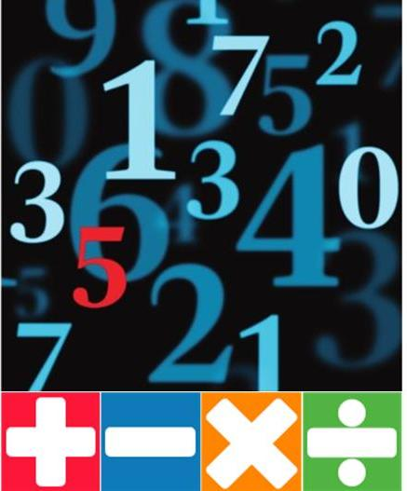
2. Arithmetic Operators
Arithmetic operators +, -, *: same as math
Division / gives the integer part
Division / works normally if used on real numbers
Division % gives the remainder of integer division
++, -- increment or decrement a variable by 1
<number>

Slide 8
Logical operators take boolean operands and return boolean
Operator ! flips the boolean operand
3. Logical Operators
Operation | || | || | || | || | && | && | && | && | ^ | ^ | ^ | ^
Operand1 | 0 | 0 | 1 | 1 | 0 | 0 | 1 | 1 | 0 | 0 | 1 | 1
Operand2 | 0 | 1 | 0 | 1 | 0 | 1 | 0 | 1 | 0 | 1 | 0 | 1
Result | 0 | 1 | 1 | 1 | 0 | 0 | 0 | 1 | 0 | 1 | 1 | 0
Credits to Georgi Georgiev for the examples
<number>

Slide 9

4. Binary Number System
We are normally using the decimal number system (base 10). For example: 657 = 6x10²+5x10¹+7x10⁰ (digits from 0 to 9)
There are other number systems. For example base 2:
11 = 1x2³+0x2²+1x2¹+1x2⁰
We can easily convert between systems.
<number>

Slide 10
Bitwise operator ~ flips the boolean operand – same as !.
The operators |, & and ^ are the same as for Boolean.
The << and >> operators move the bits left or right.
Bitwise operators only work for
5. Bitwise Operators
Operation | | | | | | | | | & | & | & | & | ^ | ^ | ^ | ^
Operand1 | 0 | 0 | 1 | 1 | 0 | 0 | 1 | 1 | 0 | 0 | 1 | 1
Operand2 | 0 | 1 | 0 | 1 | 0 | 1 | 0 | 1 | 0 | 1 | 0 | 1
Result | 0 | 1 | 1 | 1 | 0 | 0 | 0 | 1 | 0 | 1 | 1 | 0
Cool link here
<number>

Slide 11
6. Comparison operators
Comparison operators: == < > >= <= !=
<number>

Slide 12
7. Assignment Operators
Assignment Operators: = += -= |= …
<number>

Slide 13
8. Other Operators
+ can be used to concatenate strings
. is used to access object members
[ ] is used with arrays and indexers
( ) override the default order of operations
(type) is used for type casting
?: is the only ternary operator
new is used to create objects
typeof operator returns System.Type objects
is checks compatibility between objects
<number>

Slide 14
9. Type Conversions
We use explicit type conversion when we convert manually.
We use implicit when there is no loss of data or precision
<number>

Slide 15
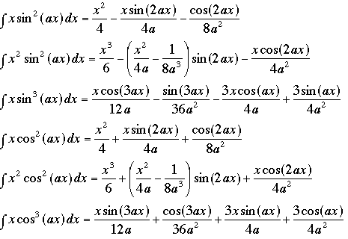
10. Expressions
Expressions are sequences of operators, literals and variables that are give a single result.
<number>

Slide 16
Homework
Write an expression that checks if given integer is odd or even.
Write a boolean expression that checks if an integer can be divided by 2, 3 and 5 without remainder (use logical operators).
Write a program that evaluates the area of a trapezium, given its sides and height.
Write an expression to check if the 3rd digit of an integer is 3. e.g. 2351 → true
Write a boolean expression for finding if the bit at position 2 (counting from 0) of a given integer is 1 or 0. e.g. If 1-> true
Write an expression that checks if a given point (x,y) is within a circle with radius 4 and centre at (0,0)
Write an expression that checks if a given positive integer n<=100 is prime.
Write a Boolean expression that returns if the bit at position p (counting from 0 ) in a given integer v has value of 1.
<number>

Slide 17



Zariba Academy
Questions
<number>

